Slide 1


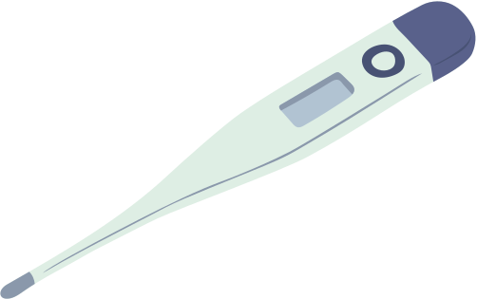



CHATDOCTOR
A Medical Chat Model Fine-Tuned on LLaMA with Medical Domain Knowledge
G614
J.SRI NITHYA (23P81A6633)
D.SHAMITHA REDDY (23P81A6919)
Y.SAI AKSHITHA (23P81A6760)
J. SRIKAR (23P81A0594)
M.ABHINAYA (23P81A6643)

Slide 2
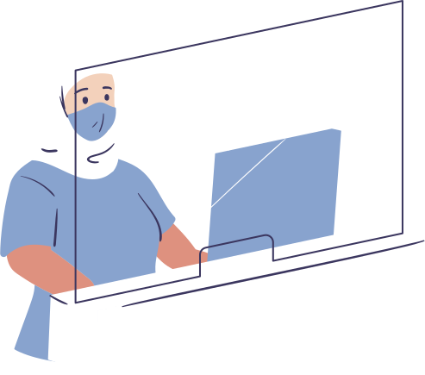

Abstract
ChatDoctor is an AI-driven healthcare platform that can analyze both text and images to provide human-like health insights.
It integrates natural language models with computer vision algorithms to interpret medicines, prescriptions, X-rays, and MRI scans.
Objective
Develop an offline multimodal AI that processes text, medicine data, and medical images, ensuring safe, factual, and explainable responses validated through medical databases. The system provides clear outputs for both patients and doctors while minimizing reliance on internet or cloud services.

Slide 3
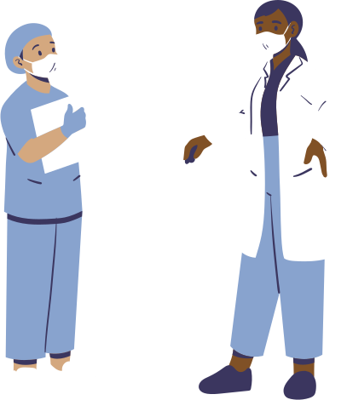
Dataset
Core Dataset:
100,000+ patient–doctor dialogues sourced from HealthCareMagic.
10,000 validation conversations obtained from iCliniq.
Supplementary Data Sources:
PubMed abstracts and MedlinePlus medical summaries for verified knowledge.
FDA drug dataset providing details on side effects and proper usage.
Dataset Features:
Includes disease–symptom–treatment relationships.
Contains diagnostic terms, test references, and medical procedures.
Preprocessing:
Data was cleaned, anonymized, tokenized, and structured to ensure quality and privacy.

Slide 4

Model Design
The system begins with Keyword Extraction, identifying key medical terms like symptoms, tests, and medicines, followed by a Database Search in the local PostgreSQL knowledge base. Using Text Ranking, it prioritizes the most relevant information based on embedding similarity.
Next, Summary Generation with BioBERT and LLaMA condenses the data while preserving accuracy, and Response Creation produces a clear, factual, and reliable answer for both patients and healthcare professionals.

Slide 5
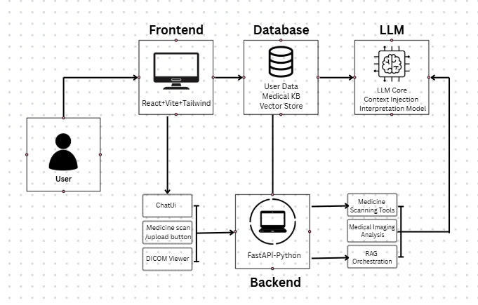
ARICHITECTURE DIAGRAM

Slide 6
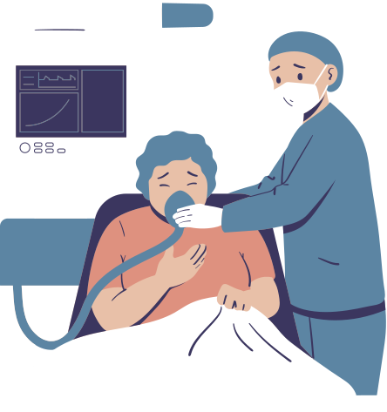
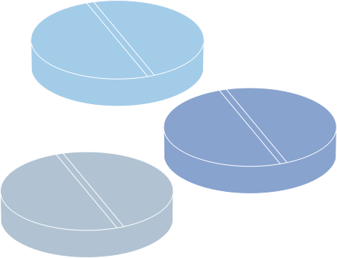
TECHNOLOGY STACK
Backend: FastAPI, Express.js – Handles model integration and API communication.
Frontend: React, TailwindCSS – Provides chat interface and upload functionality.
AI/NLP: LLaMA-3, BioBERT – Performs text generation, understanding, and interpretation.
Vision Models: CheXNet, MONAI – Used for medical image classification and segmentation.
OCR: Tesseract.js, EasyOCR – Recognizes text from medicine labels and clinical documents.
Database: PostgreSQL with pgvector – Stores embeddings, chat logs, and medical data.
Tools: VS Code, Jupyter, npm – Utilized for development, debugging, and testing.
Deployment: Localhost (Offline Mode) – Ensures secure and privacy-preserving operation.

Slide 7
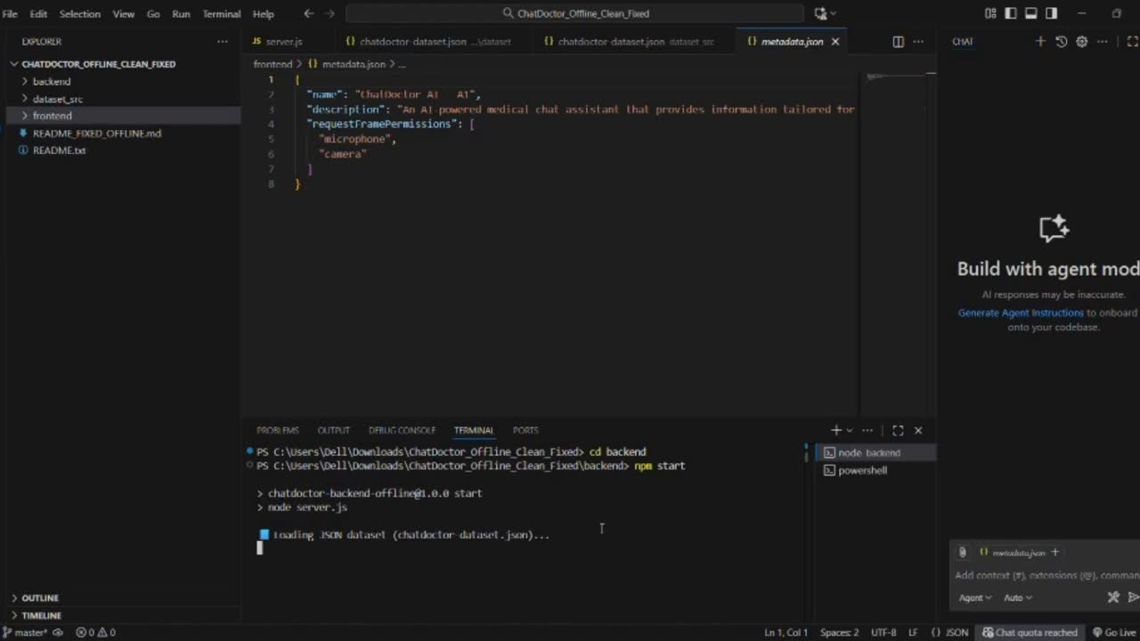

Slide 8

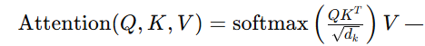
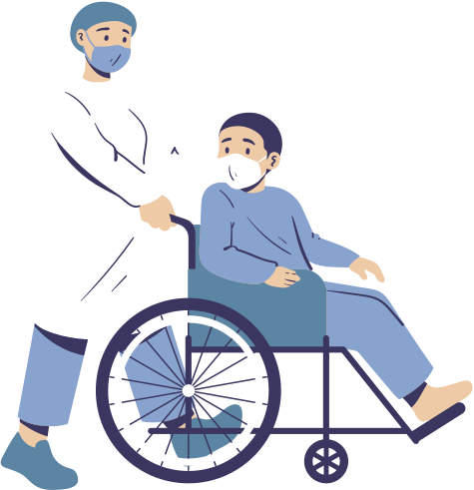
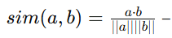
Mathematical Concepts
Transformer Encoder (LLaMA/BioBERT)
captures contextual meaning in text.
Cosine Distance (pgvector)
retrieves semantically similar medical documents.
Evaluation Metrics:
Accuracy = 91%
Precision = 0.844
Recall = 0.845
F1-Score = 0.844
BERTScore for text similarity = 0.86

Slide 9
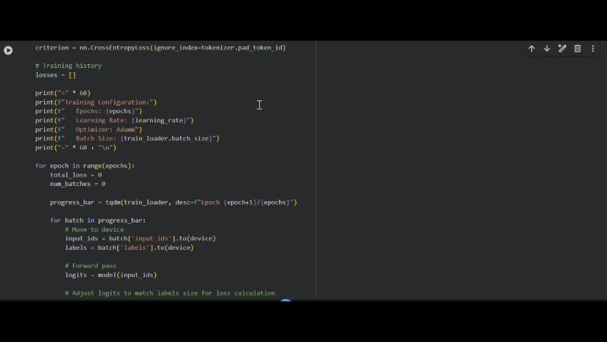

Slide 10
Qualitative Achievements
The system effectively identified emerging diseases such as Mpox and Long COVID, demonstrating adaptability to evolving medical knowledge. It generated structured medical summaries with clear disclaimers to ensure safe and responsible communication. By integrating Retrieval-Augmented Generation (RAG) validation, it enhanced factual reliability and accuracy, providing trustworthy and up-to-date medical responses for both patients and healthcare professionals.
ISSUES
Handling large medical scans (DICOM format) with limited local storage.
OCR inconsistencies in poor lighting or distorted text.
Long training times due to GPU constraints.

Slide 11
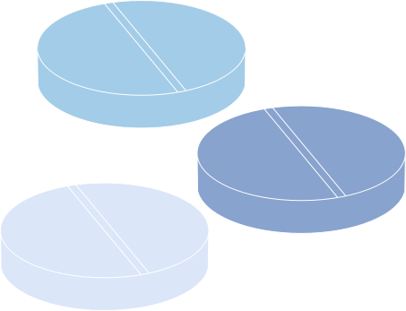
Solutions Implemented
Integrated confidence-based response filtering.
Optimized image pre-processing and resizing pipeline.
Enhanced caching for frequently accessed medical terms
FUTURE SCOPE
Mobile deployment for rural and field healthcare use.
Integration with electronic health records (EHRs) for smart data tracking.

Slide 12
Conclusion & FUTURE ENHANCEMENT
ChatDoctor demonstrates how AI combining NLP and Computer Vision can provide accurate medical insights offline.
It successfully merges image recognition and text comprehension into one cohesive platform — ensuring factual correctness, privacy, and reliability.
Collaborate with doctors for medical validation.
Expand to multilingual support (Telugu, Hindi, Tamil).

